Slide 1
UNDERSTANDING INFORMATION SYSTEMS CONTINUANCE: An Expectation Confirmation Model
NAZLI ZEYNEP BOZDEMİR
e217416

Slide 2
Contents
Motivation for the Study
Theoretical Background
Expectation-Confirmation Theory
An Expectation-Confirmation Model of IS Continuance
Model Hypotheses
Research Methodology
Instrument Construction
Data collection
Data Analysis and Results
Scale Validation
Hypothesis testing
Discussion of Results
Explaining IS Continuance intention
Explaining Satisfaction with IS Use
Conclusion

Slide 3
Motivation for the Study
This paper is one of the earliest to conceptualize and test a theoretical model of IS continuance that takes into account the distinctions between acceptance and continuance behaviors
The proposed model is based on expectation-confirmation theory (ECT)
The hypothesized model is validated empirically using data from a field survey of online banking users
Research Questions
What are the salient motivations underlying IS users' intention to continue using an IS after its initial acceptance?
How do these motivations influence continuance intention?

Slide 4
Theoretical Background

Slide 5
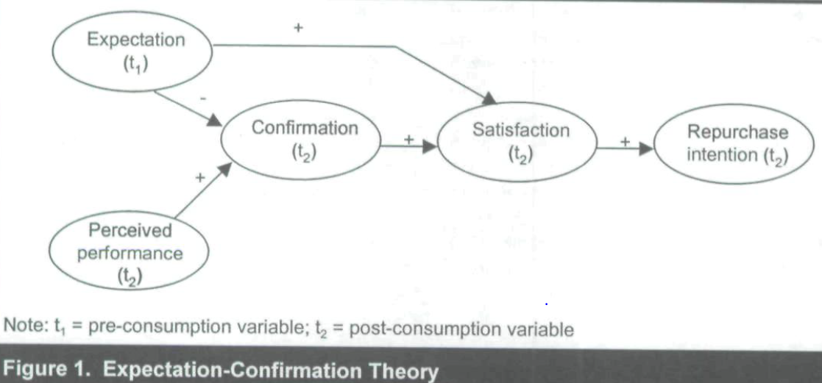
Expectation-Confirmation Theory
Consumers form an initial expectation of a specific product or service prior to purchase
They accept and use that product or service
They assess its perceived performance vis-a-vis their original expectation
They form a satisfaction, or affect, based on their confirmation
Satisfied consumers form a repurchase intention
Notes:
(Burdan başla) Expectation-confirmation theory (ECT) is widely used in the consumer behavior literature to study consumer satisfaction, post-purchase behavior, and service marketing in general
Figure 1 illustrates key constructs and relationships in ECT. The process by which consumers reach repurchase
intentions in an ECT framework is as follows
First, consumers form an initial expectation of a specific product or service prior to purchase. Second, they accept and use that product or service. Following a period of initial consumption, they form perceptions about its performance. Third, they assess its perceived performance vis-a-vis their original expectation (devam et yukarıda)

Slide 6
Criticisms of ECT
ECT ignores potential changes in consumers' expectation following their consumption experience and the impact of these changes on subsequent cognitive processes
Initial studies of ECT present varying and conflicting conceptualizations of the satisfaction construct
Conceptualization of expectation also differs across ECT studies

Slide 7
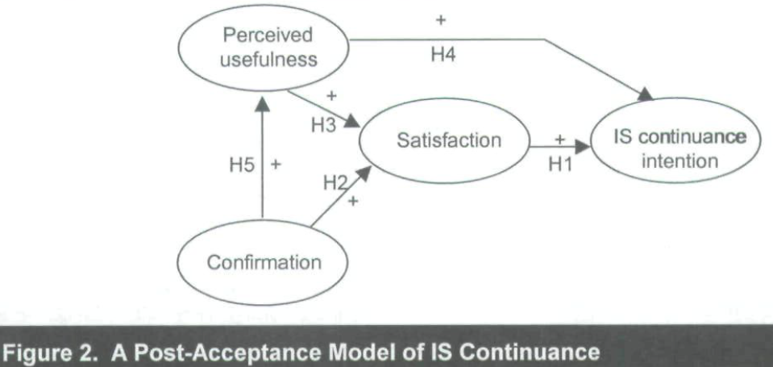
An Expectation-Confirmation Model of IS Continuance
IS users' continuance decision is similar to consumers‘ repurchase decision because both decisions
(1) follow an initial (acceptance or purchase) decision,
(2) are influenced by the initial use (of IS or product) experience, and
(3) can potentially lead to ex post reversal of the initial decision.
In order to adapt ECT to a different context (I.e., IS continuance), several theoretical extensions are required:
Notes:
(önce slide) First, while ECT examines both pre-consumption and post-consumption variables (indicated by t, and tj respectively in Figure 1), the proposed
continuance model focuses only on post-acceptance variables. This is so because the effects of any pre-acceptance variables are already captured
within the confirmation and satisfaction constructs.
Second, ECT only examines the effect of pre-consumption (ex ante) expectation, but not post-consumption (ex post) expectation. As described
before, ex post expectation is especially important for products or services where expectation may change with time, as is often the case
with IS use. Hence, the proposed continuance model amends ECT to include ex post expectation
Third, (ex post) expectation is represented in the proposed model by (ex post) perceived usefulness.
Figure 2 shows proposed associations among these constructs.

Slide 8
Hypotheses
HI. Users' level of satisfaction with initial IS use is positively associated with their IS continuance intention.
H2. Users' extent of confirmation is positively associated with their satisfaction with IS use.
H3. Users' perceived usefulness of IS use is positively associated with their satisfaction with IS use.
H4. Users' IS continuance intention is positively associated with their perceived usefulness of IS use.
H5. Users' extent of confirmation is positively associated with their perceived usefulness of IS use.

Slide 9
Research Methodology

Slide 10
Data Collection
Empirical data for this study was collected via a cross-sectional field survey of online banking users.
The sample consisted of 1,000 online customers randomly selected by OBD from its customer base of over 1 million users.
Following a single round of data collection, 122 usable responses were obtained for a response rate of about 12%.
The respondent group ranged in age from 17 to 63, were 62% male, had annual incomes between $10,000 and $250,000, subscribed to a wide range of professions, and had diverse educational levels.

Slide 11
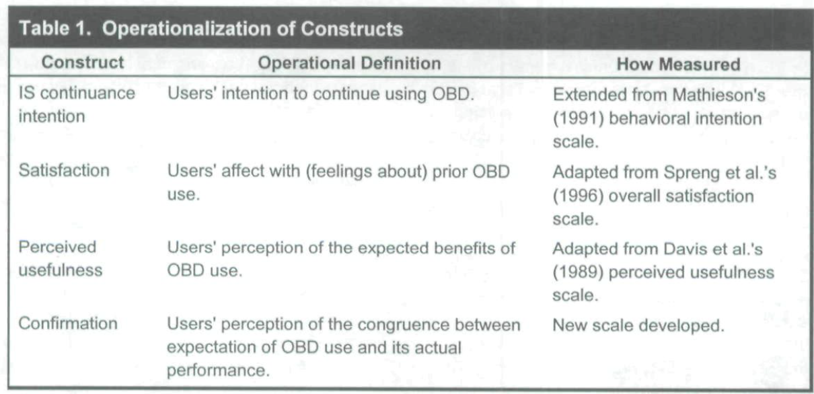
Instrument Construction
Four constructs were measured in this study: IS continuance intention, satisfaction, perceived usefulness, and confirmation

Slide 12
Data Analysis & Results

Slide 13
Scale Validation
Each scale item was modeled as a reflective indicator of its hypothesized latent construct.
The four constructs were allowed to co-vary in the CFA model.
Model estimation was done using the maximum likelihood approach, with the item correlation matrix used as input.
Following Tables (Table 2 and 3) present the results of the CFA analysis.

Slide 14
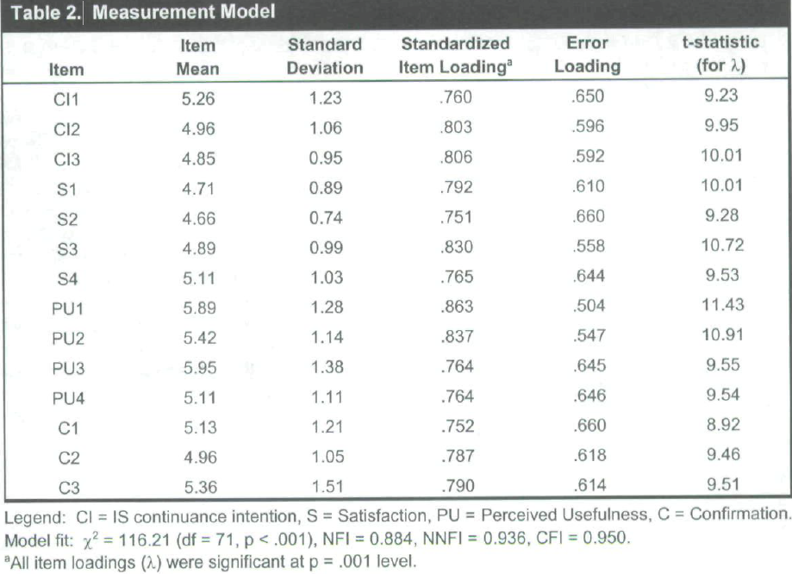

Slide 15
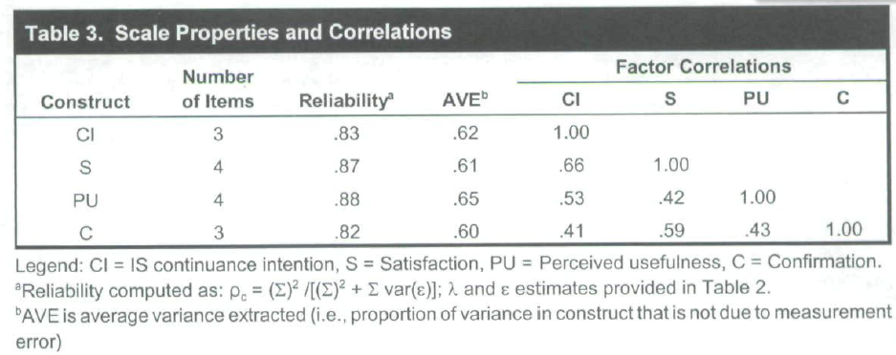
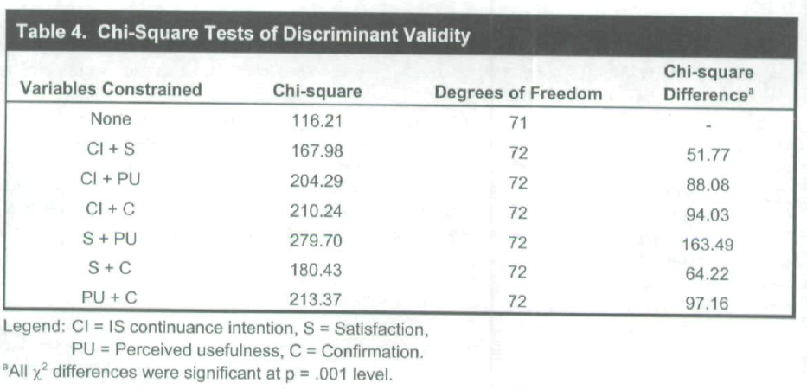

Slide 16
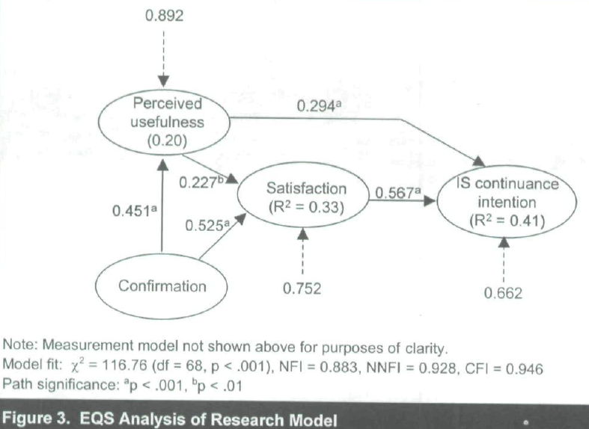
Hyphothesis Testing
The five hypotheses presented earlier were tested collectively using the structural equation modeling (SEM) approach, also performed using EQS
The goodness-of-fit of the structural model was comparable to that of the previous CFA model.
These metrics provided evidence of adequate fit between the hypothesized model and the observed data.
Notes:
Figure 3 shows the standardized path coefficients
and path significances, as reported by EQS

Slide 17
Discussion of Results

Slide 18
Explaining IS Continuance intention
Results of the study support ECT's contention that satisfaction with IS use is the strongest predictor of users' continuance intention (R^ = 0.32), followed by perceived usefulness as a significant but weaker predictor (R^ = 0.09).
Above associations suggest that satisfaction and perceived usefulness are important (indirect) predictors of actual continuance behaviors.
Perceived usefulness was a stronger predictor of acceptance intention in TAM than attitude, while satisfaction was the stronger predictor of continuance intention in this study than perceived usefulness.

Slide 19
Explaining IS Continuance intention (cont)
Because perceived usefulness is more crucial for acceptance intention and satisfaction is more dominant for continuance intention, IS firms and other supply-side institutions responsible for enhancing IS use should adopt a two-fold strategy for maximizing their return on investments in customer training:
Inform new (potential) users of the potential benefits of IS use and
Educate old (continued) users on how to use IS effectively so as to maximize their confirmation and satisfaction with IS use.
Satisfaction also may be the key to explaining the IS acceptance-discontinuance anomaly which is a little-understood phenomenon in IS use research.
Dissatisfaction, and not perceived usefulness, is the necessary condition for IS discontinuance

Slide 20
Explaining Satisfaction with IS Use
IS satisfaction may have additional salient predictors than those identified using the ECT lens
As expected from ECT, confirmation was a stronger predictor of satisfaction than perceived usefulness in the study
The larger effect size of confirmation, relative to perceived usefulness, suggests that users view realizing their expectation as being more salient than instrumentality of IS in forming affect and intention about IS continuance.

Slide 21
Limitations of the study
Given the low response rate, the results may be influenced by non-response bias
The novelty associated with an online mode of data collection may have biased the survey responses
Because respondents were current (and continuing) users of OBD, they may be biased in their perceptions, in contrast to OBD discontinuers.
Because survey respondents had used OBD between two and 36 months at the time of the survey, one may question whether perceptions of recent IS acceptors were systematically different from those of earlier acceptors
An ideal empirical design for testing ECT would be a longitudinal comparison of customers‘ pre-acceptance and post-acceptance perceptions, in order to faithfully capture the complex, dynamic interrelationships between acceptance and continuance decisions

Slide 22
Conclusion
The goal of the paper was to identify salient determinants of IS continuance intention and to understand how they influence the dependent variable
ECT was adapted and integrated with prior IS use research to theorize a model of IS continuance
Data collected from a field survey of online banking users provided empirical support
Results indicate that while post-acceptance usefulness perception continues to influence users‘ continuance intention, user satisfaction with prior use has a relatively stronger effect on the dependent variable

Slide 23
Thank you…

